Slide 1
Mathematics is Biology’s Next Microscope, Only Better;
Biology is Mathematics’ Next Physics, Only Better
-Joel E. Cohen
Franci, Kriti, Lia

Slide 2
“In biology, ensemble properties emerge at each level of organization from the interactions of heterogeneous biological units at that level and at lower and higher levels of organization...New mathematics will be required to cope with these ensemble properties and with the heterogeneity of the biological units that compose ensembles at each level.”
-Joel E. Cohen
Notes:
Nowadays, we are discovering that biology is more and more complicated. We need more advanced math to understand it.
This paper gives an overview of how we’ve used math to understand biology in the past, how we’re using it to understand it in the present, and hopefully how we’ll use it in the future as well.

Slide 3
“The Past”

Slide 4
Mathematics and Biology in the Past
Subject | Person
Age structure of stable populations | Euler
Dynamics of Interacting Species | Lotka; Volterra
Logistic equation for limited population growth | Verhulst
Diffusion Equation for Gene Frequencies | Kimura
Birth process, birth and death process | Yule; Kendall
HW equilibrium in population genetics | Hardy; Weinberg
Traveling Waves in Genetics | Fisher; Kolmogorov et al
Theory of Evolution and Genetics | George Mendel
Notes:
Here are some examples of how mathematics has been applied to biology in the past. As you can see, it was often used to model things like gene frequencies, population growth, and how species interact.

Slide 5
Hardy-Weinberg Equilibrium
Created a way to model different allele frequencies in a population
Stipulated that allele frequencies would be constant in a population assuming a set of 5 conditions were not violated
G.H. Hardy & Wilhelm Weinberg
Source: Hardy-Weinberg equation
Notes:
It was mentioned in the paper, but not discussed. So to give an example of this, Hardy and Weinberg used math to model different allele frequencies in a population using the binomial distribution function. They said that if a population met the 5 conditions that they defined (e.g. no migration into the population and random mating), then the allele frequencies wouldn’t change over time. This is important because it helps us see how the proportion of different traits, such as blue or brown eyes, can stay constant or change over time.

Slide 6
William Harvey
Disproved the theory of “arterial” versus “venous” blood
Hypothesized about the existence of capillaries, which were later observed under the microscope
Showed that blood circulated throughout the body
Pioneering the intersection of mathematics and medicine
Notes:
And the following four examples are in the paper. The first is William Harvey. He is most famous for showing that blood circulates throughout the body and for disproving the theory that were were two kinds of blood. Using metrics such as how fast the heart beat, how much blood the heart could hold, Harvey at one point found that the amount of blood coming out of a ventricle was 27 liters/hour. But he knew humans had 5 and a half liters of blood, which means that the blood had to be circulating - which means there had to be something connecting the arteries and veins, later known as capillaries. It was just mathematical intuition at the time, but he was right.

Slide 7
Geometry & Topology
Coordinate System (Rene Descartes, 1637)
Non-Euclidean Geometries (1823-1830)
Notes:
Now I’m gonna talk a little bit about how advances in three areas of math also helped further advances in biology as well.
The coordinate system developed by Descartes has many everyday uses in graphing to represent biological data. And the discovery of non-Euclidean geometries have helped us do things like map the brain onto 2D plots.

Slide 8
Algebra
Symmetries of groups of equations
Group Theory
Linear Algebra and Matrices
Notes:
The symmetries of groups of equations and group theory was used to look at the structure of crystals. And matrices were used to understand population dynamics over time.

Slide 9
Analysis
Calculus
Differential Equations
Probability Theory
Notes:
And finally, calculus, diff eq’s, probability theory were used to make even more complex advances in biology that we talked about earlier in the table we put up.

Slide 10
“The Present”
Notes:
In order to accurately predict the future of applied math and biology, Cohen believes that we should look at the present state of these fields

Slide 11
Current field of Biology
Time and space
Questions
Biological Domains
Notes:
The current field of biology can be viewed as a rectangular table
With the rows being: different questions
Columns: different biological domains,
being either: molecular, cells, tissues, organs, individuals, populations, communities, ecosystems, landscapes or biosphere
It can be further divided in time, which can range from milliseconds to billions of years, and space, which can vary from molecular to cosmic.
Complexity: subdivision of domains eg different tipes of cells, and interactions vary according time and space

Slide 12
6 questions to ask
How is it built?
How does it work?
What goes wrong?
How is it fixed?
How did it begin?
What is it for?
Notes:
These questions are related to structures, mechanisms, pathologies, repairs, functions and origins
In the purpose-related questions: there has been a movement away from theological views and towards evolutionary perspectives

Slide 13
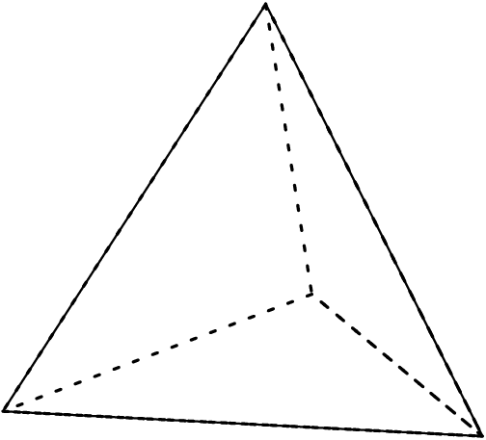
Current field of mathematics
Data structures
Algorithms
Theories and models
Computers and software
Notes:
Better represented as a tetrahedron, instead of the previously mentioned matrix
Ways to organize data
Procedures for manipulating symbols, either to analyze data or models
Allows the testing against competing theories to determine strength
This is the most visible, but due to increase in easy and cheap computing, and consequent increase in errors in software, technical knowledge is required to bridge the gap between results and understanding

Slide 14
Example:
Gene expression and drug activity in human cancer
Question: How does it work?
Domain: Human cancer cells
Method: Algorithms to show correlation and clustering according to hierarchy
Notes:
This example is used to demonstrate the research combination of biological questions, domains, spatial and time scales along with data structures, algorithms, theories, models and computational methods
Individual has cancer
Can person’s cancer cells’ gene activities give us info about which treatments are the most effective and which should be avoided?
In 2000, Sherf et al: used correlation and clustering algorithms, simple mathematical tools, to

Slide 15
Method:
2 matrices:
Target Matrix for gene expression
Drug Activity Matrix
5 Sets of correlation
Columns of Activity Matrix
Columns of Target Matrix
The rows of the Activity Matrix
The rows of Target Matrix
The rows of Activity Matrix and rows of Target Matrix
Notes:
Created two matrices, with the same column headings but different rows labels, using the National cancer institute’s drug discovery program:
Target matrix : for gene expression
Drug activity matrix
Using these two matrices they calculated all 5 sets of correlation:
The columns of activity matrix: which showed clustering of cell lines according to similar response to drugs
Target matrix columns: showed clustering of cell lines according to similar gene expression
The rows of the activity matrix: showed clustering of drugs according to activity patterns across cell lines
The rows of target matrix: clustering of genes according to the pattern of mRNA expressed across cell lines
Rows of activity matrix and rows of target matrix: showed the positive or negative correlation of drug activity with gene expression
positive : higher gene expression across cell lines, higher efficacy of drug in suppressing this activity

Slide 16
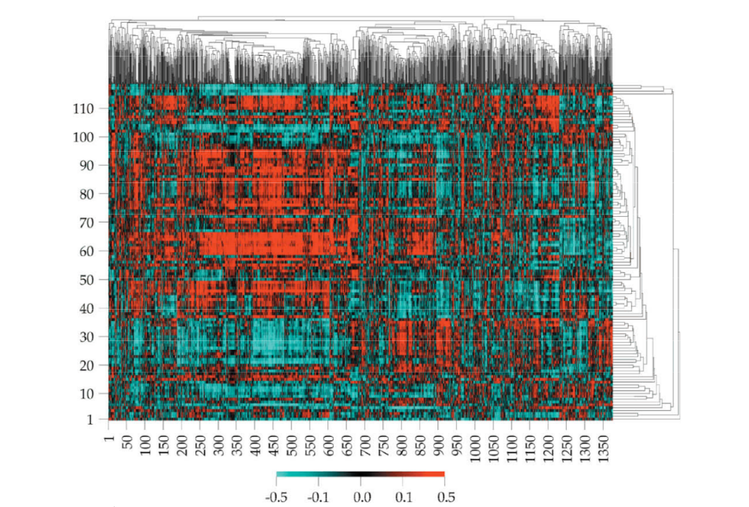
Results
Notes:
The results of the study is summarised in this picture above: called clustering image map
Plots: gene-expression-drug activity correlation
The horizontal axis: clustered genes
vertical axis: clustered drugs, only those with known function
Therefore: if a person’s cancer cells show high expression in a specific gene and that gene has a positive correlation with drug activity. Then that gene can be used as a marker for tumor cells likely to be effectively inhibited by that specific drug.
On the other hand if the correlation is negative between gene and drug activity, then this gene might indicate that the drug is ineffective.
This model provides us with useful hypothesis that require further testing
This method highlights a way of organizing and analyzing from multiple observations and it shows the importance of math in extracting meaning.

Slide 17
“The Future”
Notes:
Cohen discusses the potential for mathematics and biology and the contributions mathematics can make in answering complex biological questions.

Slide 18
Biological Questions
Cells and other complex networks
Brain: decision-making, emotions, behavior
Tree of life questions
Matching biospheres with physicochemical processes
Detecting deviations within large groups
To be Answered by Advances in Mathematics
Notes:
Certain biological questions that advances and discoveries in the field of mathematics can help to address:
Cells and complex networks that will require mathematical models to understand and interpret
Understanding the brain and why we make certain decisions, have unique behaviors, and express emotion
Mapping tree of life relationships such as the transfer of genes, genomes, and prions
Coupling changes within physical spheres with changes in organisms or species on a global or focused scale, such as changes in ocean currents and the effect on fish populations in oceans
Detecting deviations in large groups of people or organisms, such as identifying epidemics
All of these questions will be aided by complex mathematical approaches.

Slide 19
Mathematical Innovations
Computation
Modelling systems with multiple levels
Advances in understanding probability, risk, and uncertainty
Enhancing methods of analyzing large databases
Standardize mathematical research and data
Needed to Promote Progress in Biology
Notes:
These discoveries in the field of mathematics will help address biological questions.
Gaining insight into performing computations to better answer proposed questions
Modelling systems with multiple levels will help biology as many biological questions deal with the cell, organ, person, community relationship and interaction
Many biological questions deal with probability, risk, and uncertainty; Cohen discusses whether a new approach to probability is needed to address biological questions
Working on greater understanding of theory behind data analysis and developing new methods of analyzing large databases
Standardize across researchers the presentation and methods of research to help ease comparing data sets and results

Slide 20
Potential Problems
Education
Quantitative skills
Intellectual property
Knowledge helps everyone
Balance intellectual property rights
National security
Defend against biological attacks
Preserve privacy
Notes:
Potential Problems that could arise from increased mathematical analysis and tools to help with biological questions:
Education: Need to encourage math and quantitative skills at all levels of school
Intellectual property: Knowledge does help everyone but balance intellectual property rights to encourage innovation and research
National security: Defend against biological attacks and ensure that sensitive data and information is protected; additionally, preserving privacy is an important concern as much of the data needed to address biological questions is private patient data

Slide 21
Opportunities
Mathematical modelling
Perform experiments mathematically
Help with Questions Very Complex
Too large, too small, too slow, too...
Notes:
Opportunities that mathematics offers
Mathematical modelling → Perform conceptual experiments using mathematical modelling to avoid situations with ethical dilemmas or where performing actual experiments is impossible
Answer questions that are too difficult to analyze without complex mathematical models such as questions dealing with the biosphere, macroevolution, the human brain, or epidemiology of infectious diseases
(Example: Cohen and Gurtler in 2001 explored how to limit the exposure of insects carried by dogs to humans. Spraying insecticides was effective but financially difficult. Therefore, Cohen and Gurtler used mathematical models to see the effect of removing dogs from the bedrooms in households, rather than spraying. This showed that banishing dogs from bedrooms helped limit human exposure to insects on dogs without having to spray insecticides. )

Slide 22
“[M]athematics is biology’s next microscope, only better.”
-Joel E. Cohen
Notes:
this paper summarizes the past, present, and future applications of math to biology, and argues that math is becoming increasingly important to understand biology. [read quote]

Slide 23
Resources to Learn More
You can take Applied Math-Bio Courses, such as the ones below (even if you’re not an Applied Math-Bio major)...
Stat 115: Introduction to Computational Biology and Bioinformatics
MCB 199: Statistical Thermodynamics and Quantitative Biology
Math 153: Mathematical Biology-Evolutionary Dynamics
Sys Bio 200: A Systems Approach to Biology
Stat 120: Intermediate Biostatistical Methods
OEB 152: Population Genetics
...and/or work with a professor doing research in Applied Math-Bio!

Slide 24
Questions?
Notes:
this paper summarizes the past, present, and future applications of math to biology, and argues that math is becoming increasingly important to understand biology. [read quote]

